Slide 1

AGRICULTURAL PRODUCE SHOP MANAGEMENT SYSTEM (APSMS)
(Case Study: Jibidayo Agricultural Produce Shop)
BY
ATIM ABEL ATIM
BU/UP/2019/1501
atimabelatim@gmail.com
DR LUKYAMUZI ANDREW
Department of Computer Science
Faculty of Science and Education, Busitema University

Slide 2
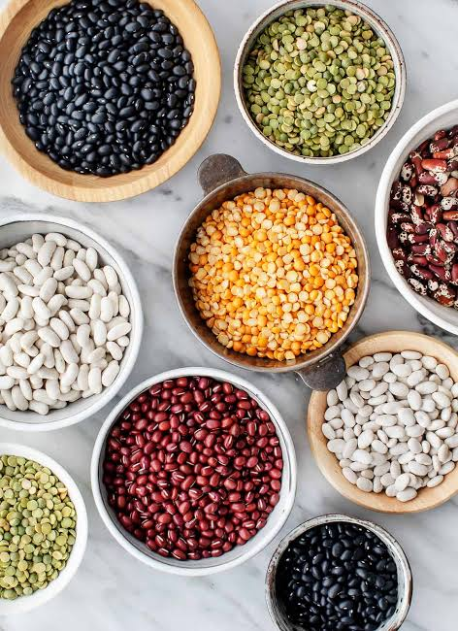
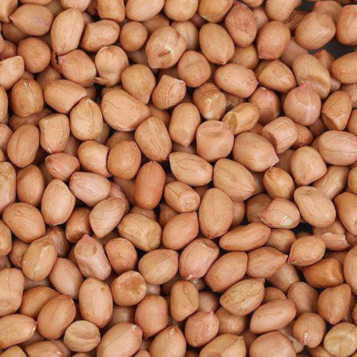
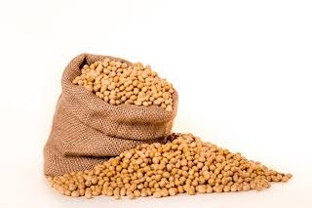
AGRICULTURAL PRODUCE SHOP MANAGEMENT SYSTEM(APSMS)
Background of the study
(APSMS) is a system that enables the manager of Jibidayo Agricultural Produce Shop(JAPS) to display the details of available agricultural produce to the customers.
Agricultural product means any agricultural commodity or product, whether raw or processed. Examples of agricultural products are, simsim, cotton, fruit, groundnuts, rice, soybean, beans, pulses, wheat.

Slide 3
The agricultural products in various parts of the world have been advertised in a traditional ways, due to technological advancement, many people have adopted the use of ICT solutions to market their products through ways like finding new customers by advertising their products. Ict solutions can empower agricultural producers through improving their marketing capabilities, in many categories of shop.(Julius Agbor,O.Taiwo and J Smith, (2012)

Slide 4
Problem statement
The system that(JAPS) is using to create awareness of the available agricultural products in the store is still manual which requires customers to travel from their places of residence to the shop to view the available agricultural produce in the shop and phone calls are also used to a smaller extent
Problems of traditional system include;
Time Consuming.
Insecurity
Inconsistency.
Due to the above challenges, the researcher has decided to develop APSMS that will enable the details of the available products in the store to be displayed online by the manager so that customers can view from whenever they are.

Slide 5
Objectives
General objective of the study
The purpose of the study is to design and implement(APSMS) which the manager of JAPS will use to create awareness about the available agricultural products in the store.
Specific objectives
Reviewing literature and determining the requirements for developing APSMS
Designing APSMS
Implementing the design of APSMS
Test

Slide 6
Significance of the study
After the system is put in place, Jibidayo Agricultural Produce Shop(JAPS) will get the following benefits.
Electronic backup
Cost saving and cost avoidance.
Data integrity.
Reducing workload.
Acting as reference.

Slide 7
Scope of the Study
The study is centered to Jibidayo Agricultural Produce Shop(JAPS) which is located within Lira city along Lira-Kitgum road and 0.5 km west of the main market in Northern Uganda. The shop is set in Odyek Ejangs's building and it became operational in 2006.The research came up an APSMS which enables the shop to create awareness of the available agricultural products in the store with ease.
The Research took me 6 months

Slide 8
The proposed system was intended to allow;
Customers view the products.
Capture the details of the customers.
Store details of each customer.
Capture the details of the products.
Store the records of the products.
Update and delete products.
Update and delete users.

Slide 9
METHODOLOGY Development methodology
The general system development methodology was Structured System Analysis Design Method (SSADM).
Rapid Application Development (RAD) was selected and prototype developed.

Slide 10
Data was collected using the following methods;
Interview method
Observation method
Document review

Slide 11
Tools Used
The main programing tools employed in the implementation includes;
My SQL database sever for implementing the back end
PHP(Hypertext Pre-processor) for functional requirements
Notepad as a text editor
CSS and JavaScript for creating user interfaces using HTML

Slide 12
Testing
Before the actual implementation, the system was tested .
Testing was done in two forms and these includes;
Unit testing.(Confirm wethere the system individual codes were working).
Integration testing. (To make sure that modules could be merged to create a fully functional system)

Slide 13
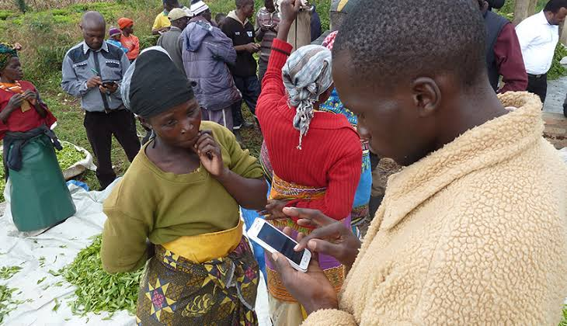
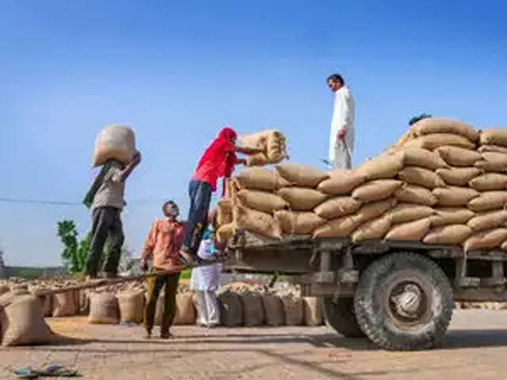
Conclusion
The system has been developed and some functionalities are working however some are not yet working due to limited resources like time, finances. However, in future, I intend to develop an application and make the system accessible to everyone across the country, the customers shall begin making orders and payments through the system, and goods shall be delivered to them physically

